Slide 1
Evaluation in HCI
Reading: David Benyon Chapter 10

Slide 2
Evaluation
In our human-centred approach to design, we evaluate designs right from the earliest idea
We start evaluating the early sketches and then as the project progresses we keep improving our prototypes and evaluate those.

Slide 3
Evaluation
Two main types
Expert Evaluation
Heuristic Evaluation
Cognitive Walkthroughs
Participant Based Evaluation

Slide 4
Evaluation
Expert Evaluation
Heuristic Evaluation
Cognitive Walkthroughs
Participant Based Evaluation
Formative Evaluation
Field Study
Controlled Experiments

Slide 5
Expert Evaluation
A simple, relatively quick and effective method of evaluation is to get an interaction design, or usability, expert to look at the system and try using it
this is no substitute for getting real people to use your design
expert evaluation is effective, particularly early in the design process.

Slide 6
Evaluation
Expert Evaluation
Heuristic Evaluation
Cognitive Walkthroughs
Participant Based Evaluation

Slide 7

Heuristic Evaluation Jakob Nielsen

Slide 8
Heuristic Evaluation Jakob Nielsen
Most usability engineering methods will contribute substantially to the usability of an interface …
If they are used

Slide 9
Heuristic Evaluation
What is it?

Slide 10
Heuristic Evaluation
What is it?
A discount usability engineering method
Notes:
Meaning it is easy (can be taught in a half day seminar)

Slide 11
Heuristic Evaluation
What is it?
A discount usability engineering method
- Easy (can be taught in ½ day seminar)
- Fast (about a day for most evaluations)
- Cheap
Notes:
Meaning it is easy (can be taught in a half day seminar)

Slide 12
Heuristic Evaluation
How does it work?

Slide 13
Heuristic Evaluation
How does it work?
Evaluators use a checklist of basic usability heuristics
Evaluators go through an interface twice
1st pass get a feel for the flow and general scope
2nd pass refer to checklist of usability heuristics and focus on individual elements
The findings of evaluators are combined and assessed
Notes:
Meaning it is easy (can be taught in a half day seminar)

Slide 14
Heuristic Evaluation Usability Heuristics (original, unrevised list)
Simple and natural dialogue
Speak the users’ language
Minimize the users’ memory load
Consistency
Feedback
Clearly marked exits
Shortcuts
Precise and constructive error messages
Prevent errors
Help and documentation

Slide 15
Nielsen: Revised 10 Usability Heuristics
(based on extensive empirical testing)
*Visibility of system status (i.e. feedback)
Match between system and the real world (speak the user’s language)
*User control and freedom (undo, redo, clear exits)
*Consistency
*Error prevention
Recognition not recall (minimize memory load)
*Flexibility and efficiency (includes shortcuts, macros)
Aesthetic and minimalist design
*Help users diagnose and recover from errors
Help and documentation

Slide 16
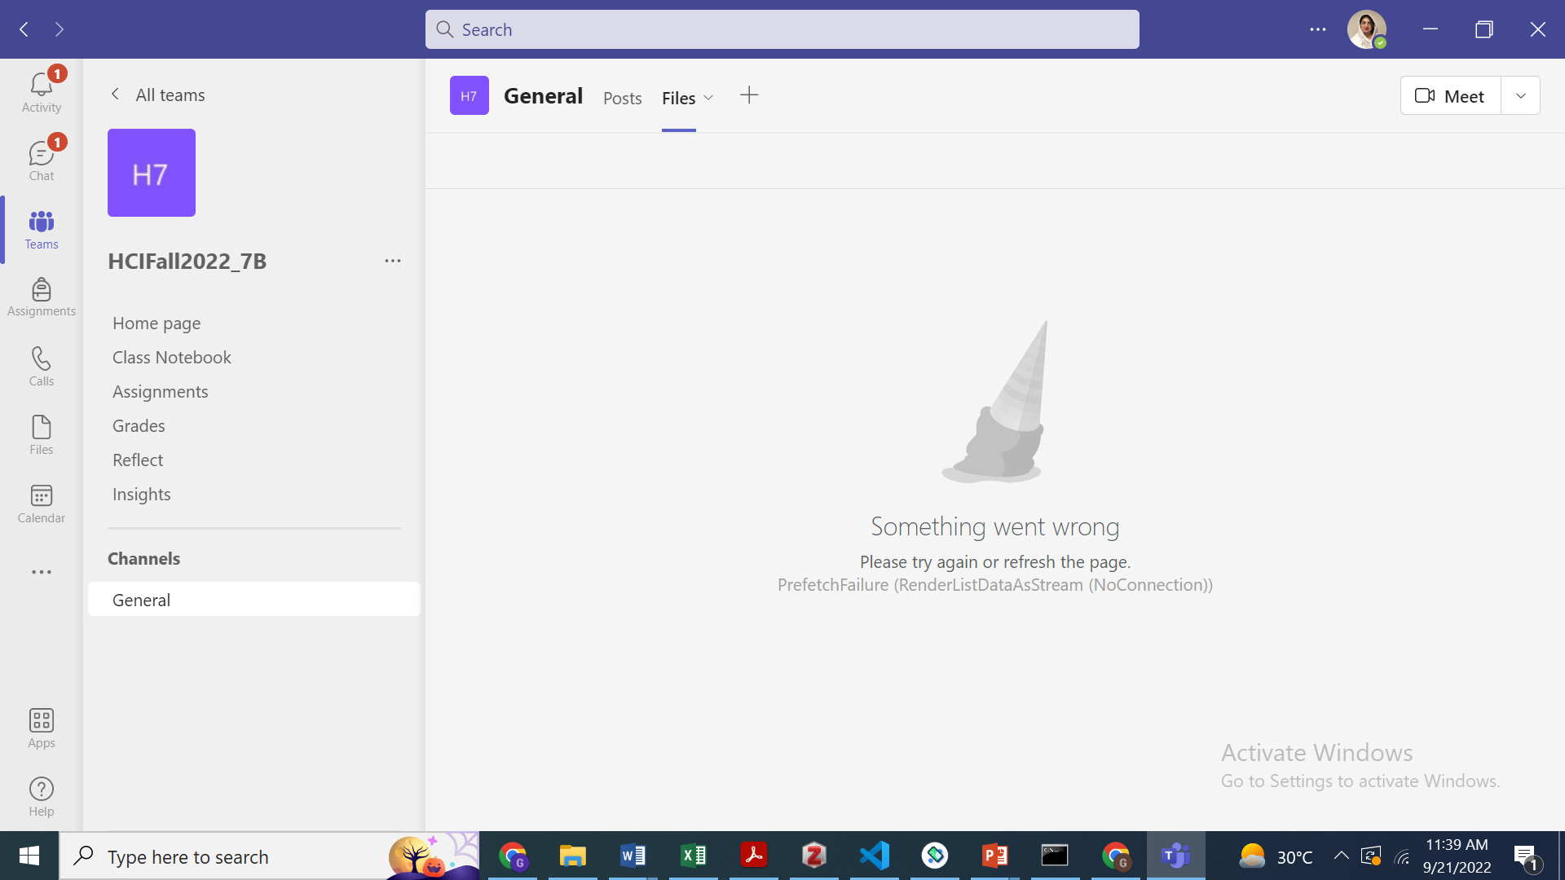

Slide 17
User Interface Principles/Heuristics (cont.)
Shneiderman’s 8 Golden Rules
Strive for consistency
Enable shortcuts for frequent users
*Offer informative feedback
Design dialogs to yield closure
*Offer error prevention and simple error handling
*Permit easy reversal of actions
*Support user locus of control
*Reduce memory load

Slide 18
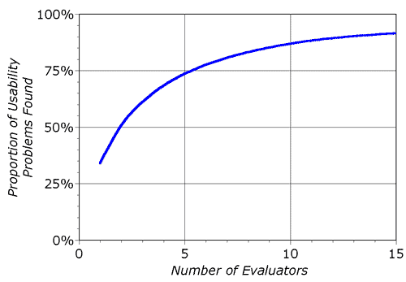
Heuristic Evaluation
One expert won’t do
Need 3 - 5 evaluators
Exact number needed depends on cost-benefit analysis
Notes:
Meaning it is easy (can be taught in a half day seminar)

Slide 19
Heuristic Evaluation
Debriefing session
Conducted in brain-storming mode
Evaluators rate the severity of all problems identified
Use a 0 – 4, absolute scale
0 I don’t agree that this is a prob at all
1 Cosmetic prob only
2 Minor prob – low priority
3 Major prob – high priority
4 Usability catastrophe – imperative to fix

Slide 20
Heuristic Evaluation
How does H.E. differ from User Testing?

Slide 21
Heuristic Evaluation
How does H.E. differ from User Testing?
Evaluators have checklists
Evaluators are not the target users
Evaluators decide on their own how they want to proceed
Observer can answer evaluators’ questions about the domain or give hints for using the interface
Evaluators say what they didn’t like and why; observer doesn’t interpret evaluators’ actions

Slide 22
Heuristic Evaluation
What are the shortcomings of H.E.?

Slide 23
Heuristic Evaluation
What are the shortcomings of H.E.?
Identifies usability problems without indicating how they are to be fixed.
“Ideas for appropriate redesigns have to appear magically in the heads of designers on the basis of their sheer creative powers.”

Slide 24
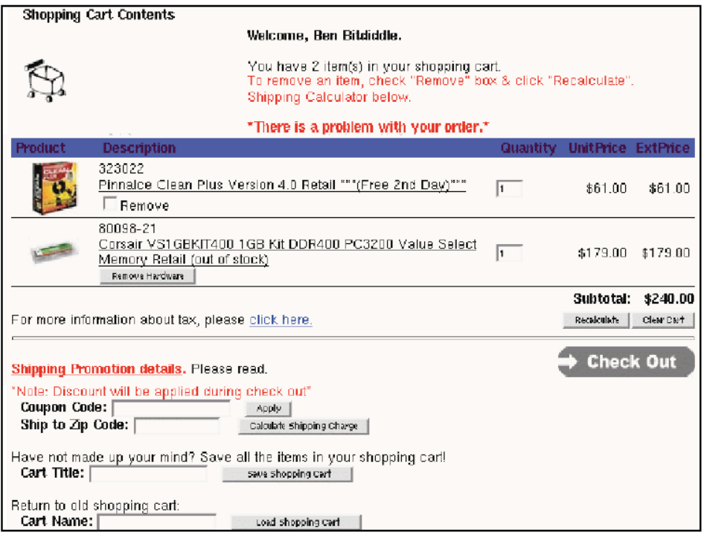
Example

Slide 25
A few problems with the Interface
Red is used both for help messages and for error messages (consistency, match real world)
“There is a problem with your order”, but no explanation or suggestions for resolution (error
reporting)

Slide 26
Continued….
No “Continue shopping" button (user control & freedom)
Recalculate is very close to Clear Cart (error prevention)
“Check Out” button doesn’t look like other buttons (consistency, both internal & external)
Must recall and type in cart title to load (recognition not recall, error prevention, efficiency)

Slide 27
Writing Good Heuristic Evaluations
Heuristic evaluations must be communicated to the developers and managers
Include positive comments as well as criticisms
“Good: Toolbar icons are simple with good contrast and few colors (minimalist design)”
Be tactful
NOT: “The menu organization is a complete mess”
Better: “menus are not organized by function”
Be Specific
Not: “Text is unreadable”
Better:”Text is too small and has poor contrast(black text on green background)”

Slide 28
Suggested Report Format
What to include:
Problem
Heuristic
Description
Severity
Recommendation (if any)
Screenshot (if helpful)

Slide 29
Evaluation
Expert Evaluation
Heuristic Evaluation
Cognitive Walkthroughs
Participant Based Evaluation

Slide 30
Cognitive Walkthrough

Slide 31
Cognitive Walkthrough
Cognitive Walkthrough = expert inspection focused o learnability
Inputs:
Prototype
Task
Sequence of actions to do the task in the prototype
User analysis

Slide 32
For each action the evaluation asks the following questions:
What is the user goal and why? (Is effect of current action same as user goal?)
Is the action obviously available? (Is the action visible?)
Does the action or label match the goal? Will the user recognize the action as the correct one?
Is there good feedback?

Slide 33
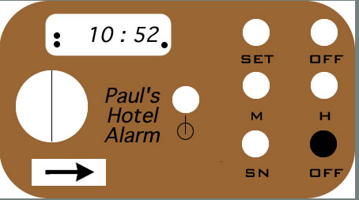
Example
Task: Set the alarm clock to 8:30

Slide 34
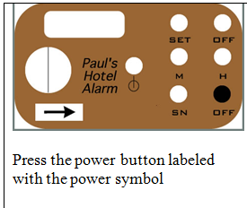
Step 1

Slide 35
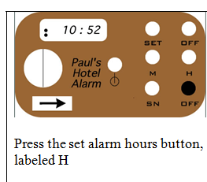
Step 2:

Slide 36
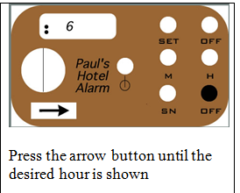
Step 3

Slide 37
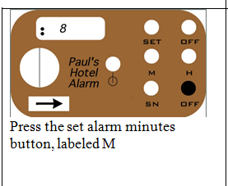
Step 4

Slide 38
